Slide 1
Solar Bike
Group 26
Austin Martratt - EE
Jared Faulkner - EE
Robert Dumont - EE

Slide 2
Motivation
Alternative transportation leads people to the use of
Electric bicycles
60 million cyclists in the U.S. alone
4% increase in bicycle usage each year
More than 200,000 electric bicycles purchased every year
Disadvantages:
Cost: $1000+
Non-modular
Bulky/inefficient

Slide 3
Goals & Objectives
Modular electric powered motor system
Solar panel integrated power system
On board electronics
Relatively low cost
Power efficient
12 mph minimum achievable speed
Variable speed via throttle

Slide 4
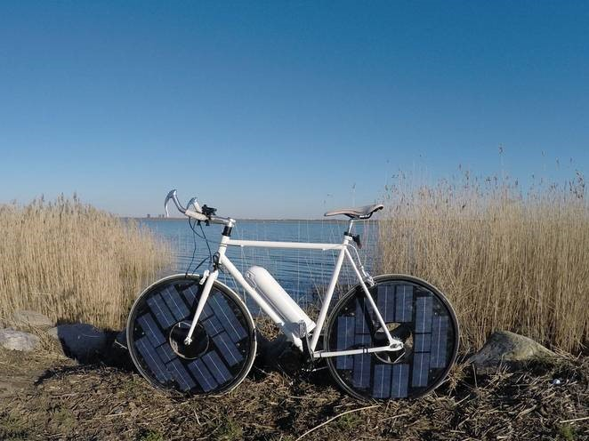
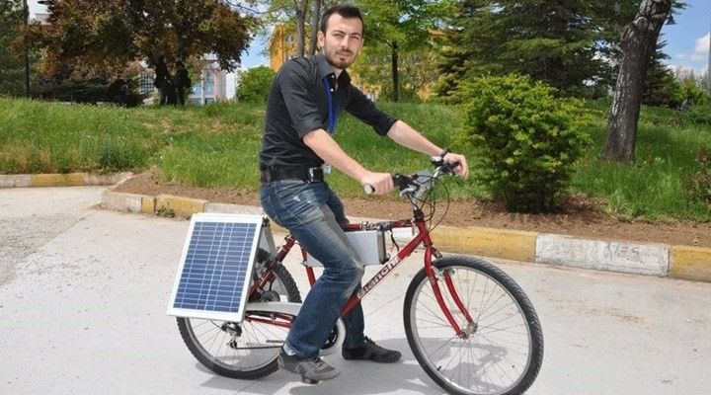
Existing Products & Research
Disadvantages:
15+ hours to charge main battery
Inefficient use of power to drive motor

Slide 5
Design Specifications
The solar charge regulator will have overcharge protection which limits the current when the battery is fully charged | The output current of the solar panel shall be, at a minimum, one tenth of the battery capacity
The program of the system must be able to compile and correctly output the speed of the bike in miles per hour (MPH) | The output voltage of the 12 V to 5 V voltage regulator must stay constant with respect to the varying input voltage from the battery, within 2 mV.
The motor shall be driven by use of pulse width modulation | The bike must be able to be manually powered by peddling when the system is not in use

Slide 6
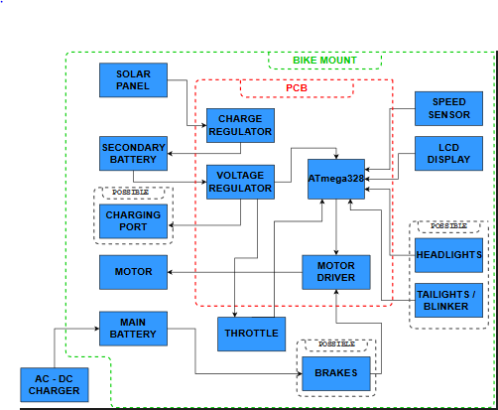
Hardware Design Diagram

Slide 7
Assembly Diagram

Slide 8
Solar Integrated Power System

Slide 9
Solar Panel
12V 10W Solar panel
Model #: RB507
Manufacturer: Gates That Open, LLC
Sponsor provided
20.7V output (Max measured)
150mA output (Max measured)
Notes:
Sponsor provided

Slide 10
Battery - Solar
Sealed lead-acid
12V - 1.4Ah
Model #: SP12-1.2
Manufacturer: SigmasTek

Slide 11
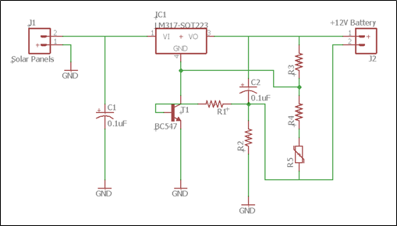
Charge Regulator
Requirements:
The output voltage must remain constant –13.7V
The output current must remain constant - 100mA
Overcharge protection
Adjustable output

Slide 12
Component Selection – Charge Regulator
 | BQ24450 | LM317*
Cost | $6.76​ | $1.62​
Manufacturer | Texas Instruments​ | Texas Instruments​
Uses | Battery charging​ Voltage and current regulation​ | Battery charging​ Voltage and current regulation​
Pros | Little external modifications​ Constant voltage and current Temperature reference​ | Constant voltage and current​ Can be expanded Used in many other applications
Cons | Price | Setup and features

Slide 13
Voltage Regulator
Requirements:
Efficient
Output voltage must stay constant with varying input voltage
In the case a USB is added to the design, must output at least 2A

Slide 14
Component Selection – Voltage Regulator
 | LM7805 | LM317 | LM2576
Cost | $0.62 | $1.62 | $2.68
Manufacturer | Texas Instruments | Texas Instruments | Texas Instruments
Max Current | 1.5 A | 1.5 A | 3.0 A
Pros | Cost | Current Regulation | Higher current Efficiency
Cons | Current restrictions Efficiency | Current Restrictions Efficiency | Price Inductor
Efficiency | 40% | 44% | 77%
Notes:
Add in efficiency

Slide 15
Control Circuit

Slide 16
MCU
In this design, the ATmega328 MCU will be used.
1. PWM Generation – motor speed variation
2. Throttle Control – User speed control
3. LCD Information – display data to user for convience
4. Speed Sensing – accurately calculate speed of bike

Slide 17
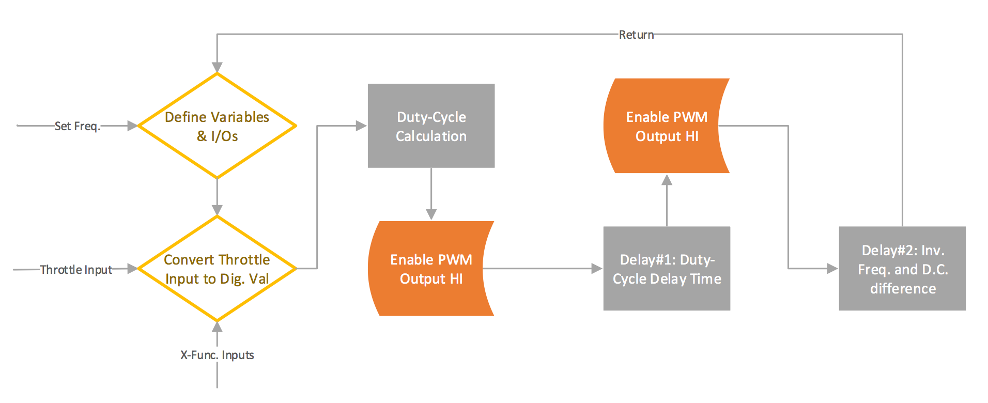
Software Design Diagram (PWM Generation)

Slide 18
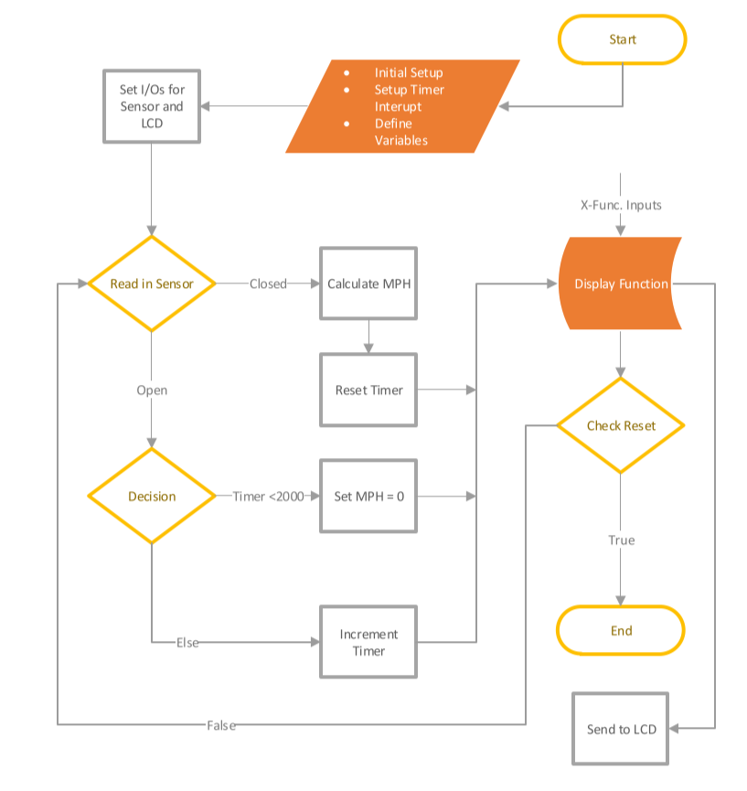
Software Design Diagram (LCD & Speed Sensor)

Slide 19
MCU Comparison
Feature | ATmega328 | MSP430G2553 | BCM2837
Operating Voltage | 1.8 – 5.5V | 1.8 – 3.6V | 2.5 – 6.0V
Temperature Range | -40°C to 85°C | -40°C to 85°C | -25°C to 80°C
Max Clock Frequency | 20 MHz | 16 MHz | 1.2 GHz
Memory | 32 KB Flash, 1 KB EEPROM, 2 KB SRAM | 16 KB Flash, 0.5 SRAM | 512 KB L2 Cache
Analog I/O | Input Only | Both | Both
Digital I/O | Both | Both | Both
GPIO Pin Count | 20 | 24 | 40
Bit count | 8-bit | 16-bit | 64-bit
Low Power | Yes | Yes | Yes
Board Price | $16.06 | $19.83 | $35.99
Arduino Uno Rev 3
MSP430 Launchpad
Raspberry Pi 3

Slide 20
PWM Control
Signal will be generated by the MCU#1
Will control the switching of the MOSFETs in the Motor circuit
Signal will vary in duty cycle to control the speed of the motor

Slide 21
PWM vs. Variable Resistance
Power Consumption
Transistors in PWM mode have very low impedance and therefore a low voltage drop and low power dissipation.
Control Behavior
With PWM, the motor will 'see' a very low power supply impedance thus resulting a much higher torque in the motor. With a series resistance, the motor will ‘see’ a weak power supply and most likely will stall.
Circuitry Cost
Transistor switching can be easily controlled by a microcontroller where a variable resistance will need more expensive circuitry to properly control.

Slide 22
LCD
16x4 Serial LCD Module w/ Blue Backlight
Uses:
Speed Display
Battery Charge Level
Clock
Trouble shooting
Messages
Trip Tachometer

Slide 23
Reed Sensor
Objective: send a HI voltage to MCU when magnet on wheel hovers over reed switch.
Magnet will be attached to the rear wheel on the spokes.
MCU will measure time in between cycles to convert to a speed.

Slide 24
Throttle
Potentiometer
Hall Sensor
Contact device
Wear may cause issues
Power loss
Non-contact device
Very reliable
Low power loss

Slide 25
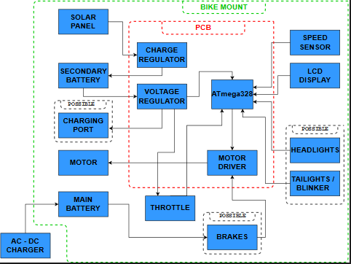
Motor Circuit

Slide 26
Motor Circuit
Goal: toggle the motor voltage at different pulse widths to control speed
MOSFET driver (PWM controlled) switches the MOSFETs that are in series with the motor
Motor is powered by the primary battery

Slide 27
Motor
Single Phase Induction Motor
Max continuous power output rated for 350W @24V
Manufacturer: Alvey
9 tooth 1/8” bike chain sprocket

Slide 28
Motor Battery
24V 10Ah Li-ion Bottle Battery
Rated 250W at continuous power consumption
Main power for motor drive

Slide 29
Schematics and PCBs

Slide 30
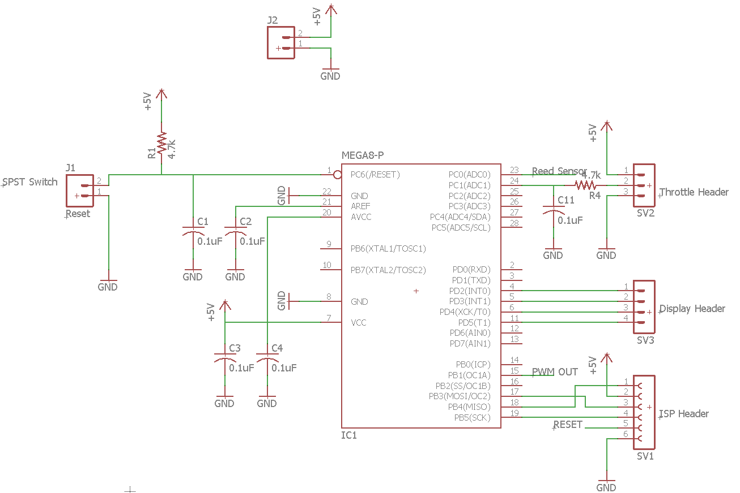
Motor Control

Slide 31
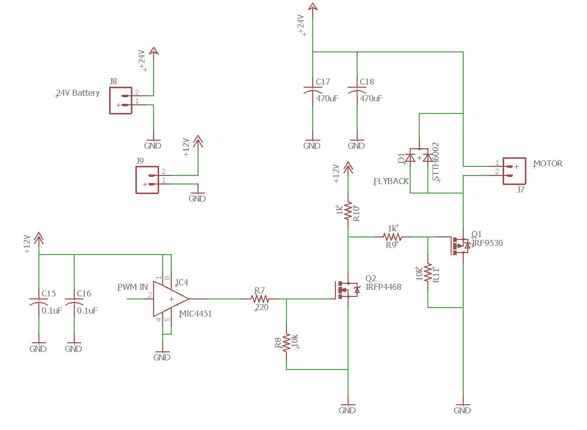
Motor Control

Slide 32
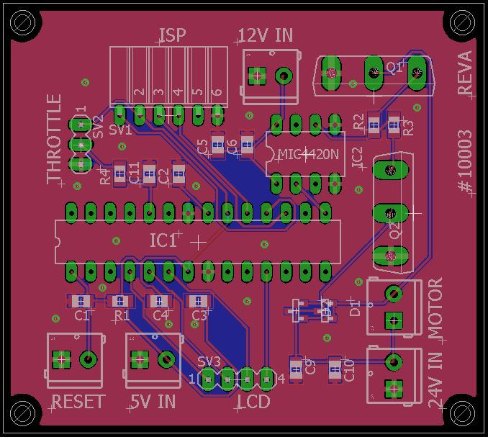
Motor Control

Slide 33
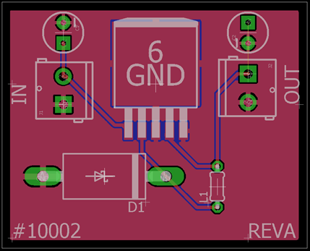
5V Voltage Regulator

Slide 34
Solar Panel Charge Regulator

Slide 35
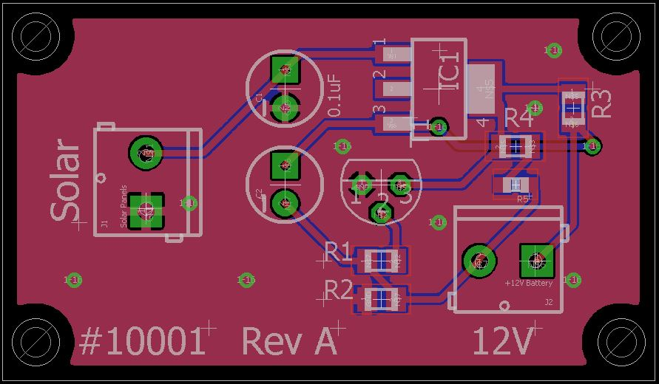
Solar Panel Charge Regulator

Slide 36
Administrative Content

Slide 37
Financing
Sponsor: 4F Structural Concrete & Masonry
Budget: $1000
Product Value: <= $500
Sponsor Requirements:
Must be blue in color

Slide 38
Budget
Subsystem | Part Description | Quantity | Price
Bike Chassis | 26” Men’s Genesis V2100 Mountain Bike | 1 | $106.00
Control Circuit | ATmega328 MCU (Arduino UNO) | 2 | $32.12
 | 16 x 4 Character Blue Backlight LCD | 1 | $9.36
 | Throttle (Hall Effect) | 1 | $15.90
 | UPG UB1250 Lead Acid Battery (12V) | 1 | $14.98
Solar | Solar Panel (12V) | 1 | $0.00 ($139.00)
Motor Driver | Alvey 24V-350W MY1016Z3 Electric Motor (Single Phase) | 1 | $94.99
 | Lithium Ion Battery (24V – 11Ah) | 1 | $200.00
 | PCB (Control Circuit / Solar Charge Regulator / Motor Driver) | 1 to 3 | $50.00
 | Miscellaneous (Resistors, chips, Capacitors, etc.) | - | $50.00 (Est.)
 |  | Total: | $467.35

Slide 39
Project Responsibilities
Name | Software | Solar | Motor Control | PCB design
Austin |  |  |  | X
Jared | X |  | X
Robert |  | X

Slide 40
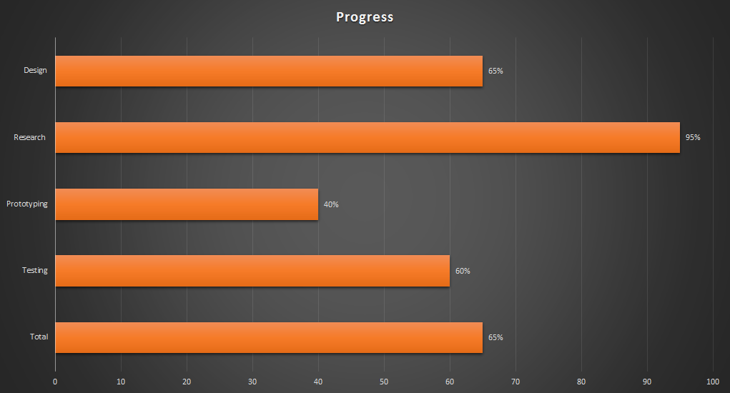
%

Slide 41
Issues and Concerns
Weight requirements
Mounting the motor and solar panel
Charge regulator
Reducing start-up amperage draw from the motor
Blew out the acquired throttle

Slide 42
Going Forward
2 MCU design to avoid parallel processing
Isolate the PWM and throttle from the speed sensor and LCD output
Integrating all subsystems onto one PCB
Isolate different voltages to avoid multilayer board cost

Slide 43
Possible 2 MCU Diagram

Slide 44
Questions?

